Slide 1


CS214 – Data Structures
Lecture 10: Stacks
Slides by
Mohamed El-Ramly, PhD
Basheer Youssef, PhD
Notes:
Polls in slides:
in lecture 1: 24,29,31,32,42,46
in lecture 2: 65,84,102,103,108,117,130

Slide 2
Agenda
  Stacks and their operations
  Stacks’ implementations
  Stack’s applications
  Queues and their operations
  Queues’ implementations
  Queues’ applications

Slide 3
Agenda
  Stacks and their operations
  Stack’s applications
  Stacks’ implementations
  Stack in STL ??????

Slide 4
Stacks
A stack is a linear simple data structure that can only be accessed at one of its ends for data storage and retrieval.
It is LIFO structure.
It resembles a stack of plates in a cafeteria.
A stack may have limited capacity or may be expandable.

Slide 5
Stack Operations
clear () empties the stack
isEmpty() returns true if the stack is empty
push (item) puts item at the top of the stack
pop () removes and returns the topmost item in the stack
top () returns the topmost item in the stack without removing it

Slide 6

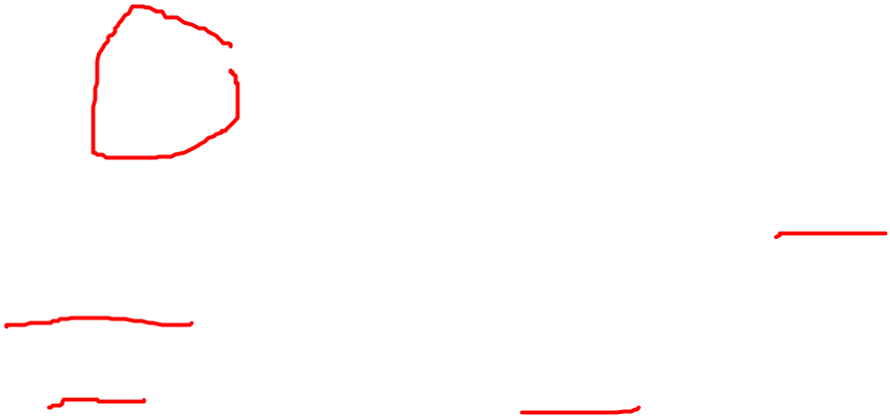
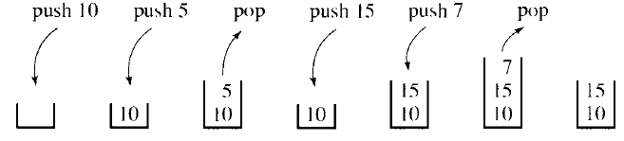
Stack Example
Try this sequence of operations
  push (10)
  push (5)
  pop
  push (15)
  push (7)
  pop

Slide 7
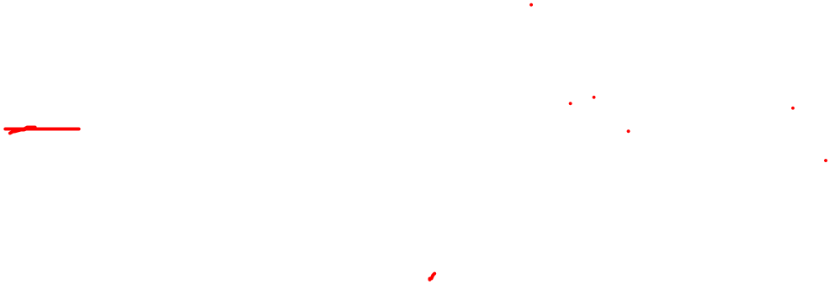
Stack Applications
Stacks are useful if data has to be stored and then retrieved in a reverse order.
Examples:
  Memory stack for storing function activation records.
  Bracket (balanced) delimiters checking (part of any compiler)
  Adding big integers
  Evaluating postfix expressions
  . . . . . . . . . . . .

Slide 8
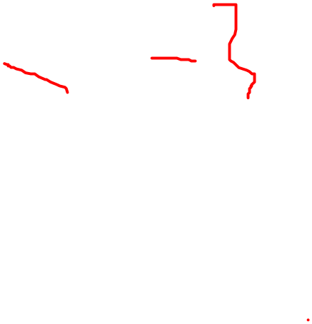
App. 1. Bracket delimiters checking
Delimiters | Description
( and ) | Parentheses. The Lisp programming language syntax is cited as recognizable primarily by its use of parentheses.
{ and } | Curly brackets.
< and > | Angle brackets.
" and " | commonly used to denote string literals.
' and ' | commonly used to denote string literals.^{[10]}
<? and ?> | used to indicate XML processing instructions.
/* and */ | used to denote comments in some programming languages.

Slide 9
Chapter 4: Stacks and Queues

Slide 10
Bracket delimiters checking
Example:
a = (b + c) * (d – e) / f ;
while (m < (n[9] + a)) {p = 7; /* comment */}
Example:
a = (b + c) * (d – e) / f) ;
while (m < (n[9 + a)) {p = 7; /* comment */}
Develop an algorithm to check bracket
Apply it on these example
Extend to include “ “ and < >

Slide 11
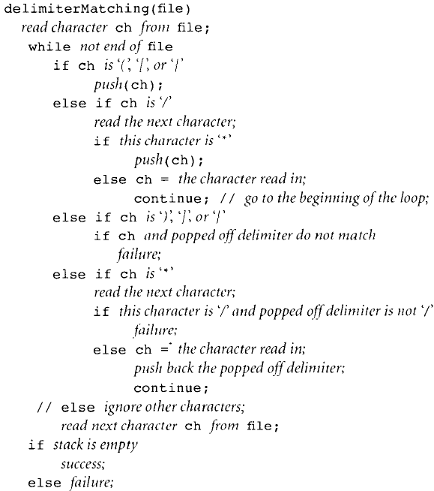
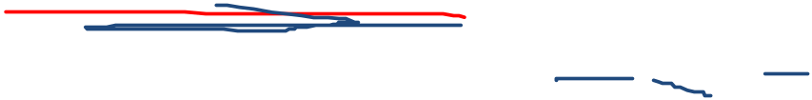

Read character
Opening delimiter?
Push into stack
Forward Slash?
Bracket delimiters checking
Star?
It is start of comment
Not comment
Closing delimiter?
Pop & check match
Star?
Is next / ?
Check match
Ignore non-delimiter
Read next
Empty stack at end? SUCCESS

Slide 12
Apply: Bracket delimiters checking
s = t[5] + u / (v * (w + y));
  Show stack after each character

Slide 14
App. 2. Big Integer Addition
addLargeNumbers
Store the digits of the first num (from left) in a stack
Store the digits of the second num in a stack
result = 0
While one stack is not empty
  Pop a digit from each non-empty stack and add them to result
  Put the unit part of result in a sum stack
  Store the carry part in result
If result is non zero push in sum stack
Pop sum stack and present as you popo

Slide 15
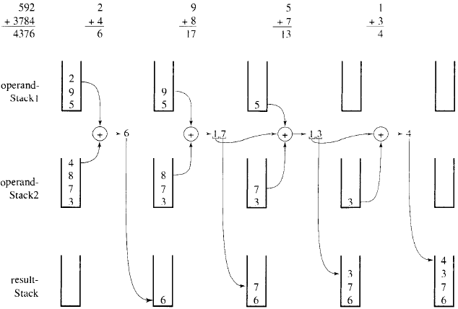
App. 2. Big Integer Addition

Slide 16
Chapter 4: Stacks and Queues

Slide 17
App. 3. Evaluation Postfix Expressions
Expressions we use are infix
  3 + 4 * 4 – 5 * 8 / 4 + 3
  (3 + 4) * (4 – 5) * 8 / (4 + 3)
They can also be represented in postfix notation
  3 4 4 * + 5 8 * 4 / – 3 +
  3 4 + 4 5 – * 8 * 4 3 + /
  What is the benefit of this notation?
  How can it be evaluated using a stack?

Slide 18
Vector-based Implementation
Build your own
See the book ???
See the uploaded code ???

Slide 19
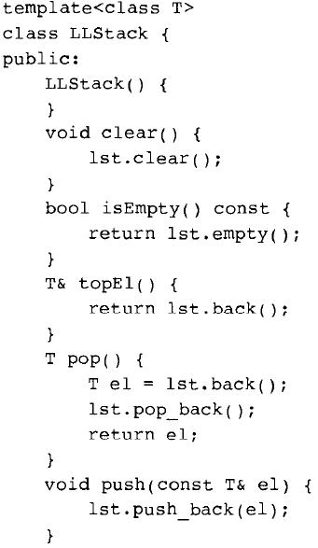
LL-based Implementation

Slide 20
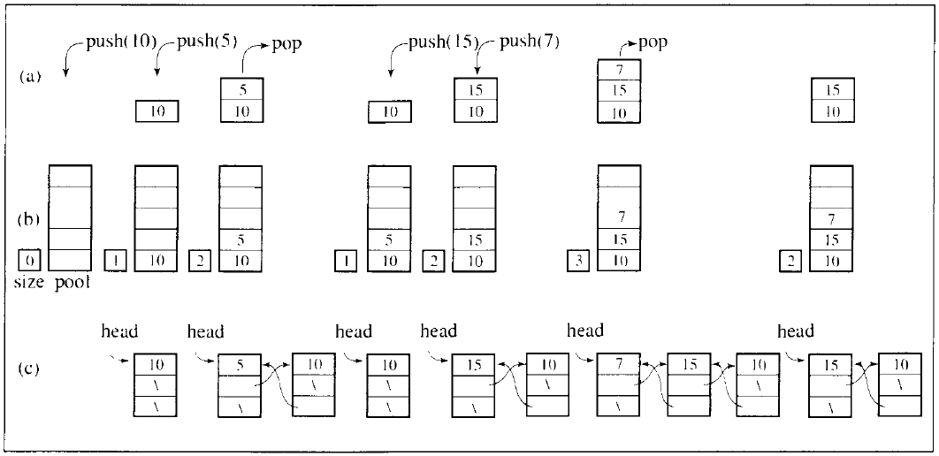
Chapter 4: Stacks and Queues

Slide 21
Implementations’ Comparison
There can be also an array-based implementation.
What is the performance of main operations in various implementations?
What is the overhead (extra space or time) caused by each implementation?
What is the difference between DLL and SLL implementations?

Slide 22
Chapter 4: Stacks and Queues

Slide 23
Stack in the STL
STL has a container adaptor stack
A container adaptor is a class that use an encapsulated object of a specific container class as its underlying container.
It provides a specific set of member functions to access its elements.
The underlying container may be a standard container or another one that supports the following operations:
    back()
    push_back()
    pop_back()

Slide 24
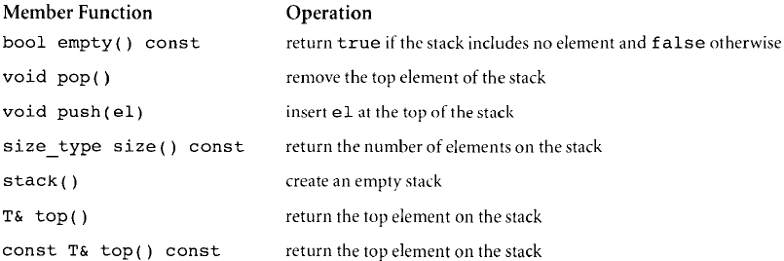
stack member functions

